Slide 1
Agile
Presented By :-

Slide 2
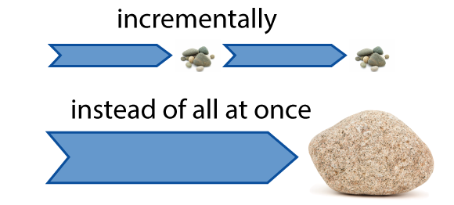
What Do You Mean By Agile?
Agile is a time boxed, iterative approach to software delivery that builds software incrementally from the start of the project, instead of trying to deliver it all at once near the end.

Slide 3
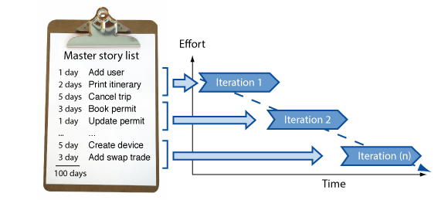
It works by breaking projects down into little bits of user functionality called user stories, prioritizing them, and then continuously delivering them in short two week cycles called iterations.

Slide 4
Agile Frameworks
Some of the most popular frameworks amongst all of them are:
Scrum
Kanban
Extreme Programming

Slide 5
Advantages of Agile Methodology
The customers continuously get a look and feel of the project progress at the end of each iteration/sprint.
Each sprint provides the customer with a working software which meets their expectations as per the definition of done provided by them.
The development teams are quite responsive to the changing requirements and can accommodate changes even in the advanced stages of development.

Slide 6
Disadvantages of Agile Methodology
Comprehensive documentation is not preferred
The requirements are not always crystal clear.
Not suitable for large projects
Less structured

Slide 7
Scrum Overview
Scrum can easily be considered to be the most popular agile framework.
The word scrum comes from the sports rugby. Where the players huddle together in an interlocked position pushing against the opponents. Each player has a defined role in their position and can play both offensive and defensive as per the demand of the situation.
Similarly, the scrum in IT believes in empowered self-managed development teams with three specific and clearly defined roles. These roles include – Product Owner (PO), Scrum Master (SM) and the development team consisting of the programmers and testers. They work together in iterative time boxed durations called sprints.

Slide 8
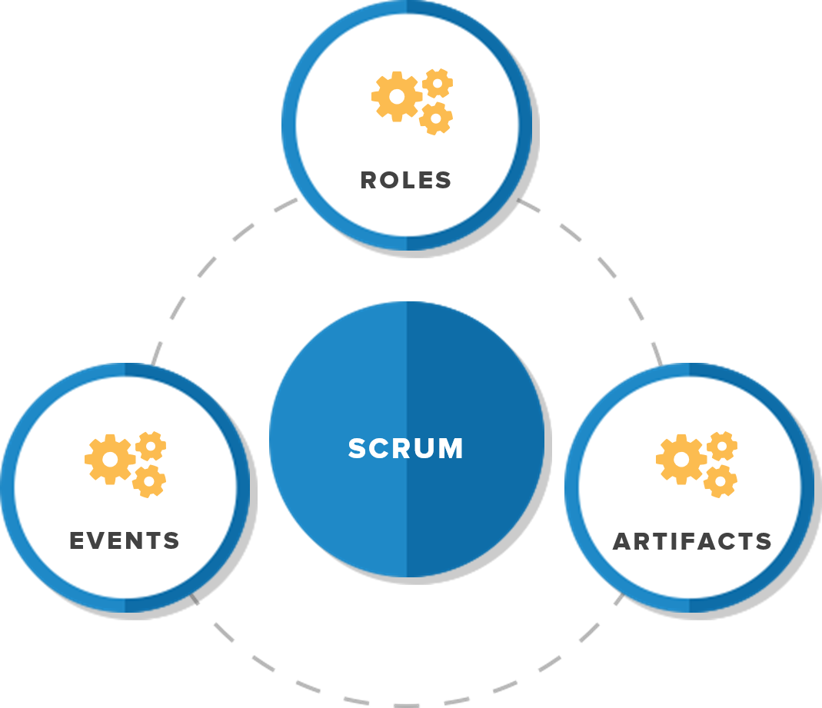
Key ideas behind scrum
Roles: Scrum divides the team into three primary roles—product owner, scrum master and the development team.
Events: Scrum events include sprint planning, daily scrum, sprint review and sprint retrospective. Teams use these events to execute projects and refine the process.
Artifacts: Scrum artifacts include the product backlog, sprint backlog and increment. Collectively, these allow teams to prioritize tasks and deliver projects within agreed timelines.

Slide 9
Scrum Master
Scrum Master is the facilitator of the scrum team. He/she makes sure that the scrum team is productive and progressive. In case of any impediments, scrum master follows up and resolves them for the team. SCRUM Master is the mediator between the PO and the team.
He/she keeps the PO informed about the progress of the Sprint. If there are any roadblocks or concerns for the team, discusses with the PO and gets them resolved. Like the team’s Daily Standup, a standup of the SCRUM Master with the PO happens every day.

Slide 10
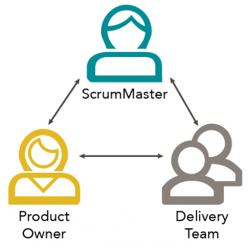
Product Owner

Slide 11
User Stories
User stories are nothing but the requirements or feature which has to be implemented.
In the scrum, we don’t have those huge requirements documents, rather the requirements are defined in a single paragraph, typically having the format as:
As a <User / type of user> I want to <Some achievable goal/target> To achieve <some result or reason for doing the thing>

Slide 12
Sprint planning
Sprint planning is an event in the Scrum framework where the team determines the product backlog items they will work on during that sprint and discusses their initial plan for completing those product backlog items.
Teams may find it helpful to establish a sprint goal and use that as the basis by which they determine which product backlog items they work on during that sprint.
People involved :-
Product Owner - Identifies the candidate product backlog items and their relative priorities, as well as proposes a sprint goal.
Team members - Determine how many of the product backlog items they forecast they will be able to complete and determine how they will deliver those product backlog items.
Scrum Master - Facilitates sprint planning in order to ensure that the discussion is effective and that there is agreement to the sprint goal and that the appropriate product backlog items are included in the sprint backlog.

Slide 13
Structure of Sprint Planning
Sprint planning is typically split into two parts:
Part 1 - Scope
The team selects which items from a prioritized list of ready product backlog items (usually expressed as user stories) they forecast they will be able to complete during the sprint.
Here’s a sample agenda for the first part of sprint planning:
What is the goal for this sprint? Use this as a decision filter to determine which product backlog items to include in the sprint.
What product backlog items are ready and contribute toward the sprint goal?
Who is available for this sprint? Identify any vacations, holidays, other activities that will impact everyone’s availability during the sprint.
What is the team’s capacity based on everyone’s availability
What items will the team include on the sprint backlog based on the sprint goal and the team’s capacity.
How confident does the team feel that they’ll be able to meet the sprint goal.
Part 2 - Plan
The team discusses in more detail how they will deliver the selected product backlog items. This may (but does not have to) include identifying tasks for the product backlog items, whether there are any dependencies between the items, and signing up for the initial product backlog items that each team member works on .

Slide 14
Heartbeat Retrospective
The team meets regularly, to explicitly reflect on the most significant events to have occurred since the previous such meeting, and take decisions aiming at remediation or improvement.
This is often a facilitated meeting following a set format. Several distinct formats have been described, depending in large part on the time set aside for the meeting, typically between one and three hours. One important reason to use a facilitated format is to give all team members an opportunity to speak up.

Slide 15
A retrospective is intended to reveal facts or feelings which have measurable effects on the team's performance, and to construct ideas for improvement based on these observations. It will not be useful if it devolves into a verbal joust, or a whining session.
On the other hand, an effective retrospective requires that each participant feel comfortable speaking up. The facilitator is responsible for creating the conditions of mutual trust; this may require taking into accounts such factors as hierarchical relationships, the presence of a manager for instance may inhibit discussion of performance issues.
Being an all-hands meeting, a retrospective comes at a significant cost in person-hours. Poor execution, either from the usual causes of bad meetings (lack of preparation, tardiness, inattention) or from causes specific to this format (lack of trust and safety, taboo topics), will result in the practice being discredited, even though a vast majority of the Agile community views it as valuable.
An effective retrospective will normally result in decisions, leading to action items; it's a mistake to have too few (there is always room for improvement) or too many (it would be impractical to address "all" issues in the next iteration). One or two improvement ideas per iteration retrospective may well be enough.
Identical issues coming up at each retrospective, without measurable improvement over time, may signal that the retrospective has become an empty ritual.

Slide 16
BurnDown Chart
It can be described as a large graph relating the quantity of work remaining (on the vertical axis) and the time elapsed since the start of the project (on the horizontal, showing future as well as past). This constitutes an “information radiator", provided it is updated regularly. Two variants exist, depending on whether the amount graphed is for the work remaining in the iteration ("sprint burndown") or more commonly the entire project ("product burndown").

Slide 17
Poker Planning
A playful approach to estimation, used by many Agile teams.
The team meets in presence of the customer or the product owner. Around the table, each team member holds a set of playing cards, bearing numerical values appropriate for points estimation of a user story.
The Product Owner briefly states the intent and value of a story. Each member of the development team silently picks an estimate and readies the corresponding card, face down. When everyone has taken their pick, the cards are turned face up and the estimates are read aloud.
The two (or more) team members who gave the high and low estimate justify their reasoning. After brief discussion, the team may seek convergence toward a consensus estimate by playing one or more further rounds.

Slide 18
Benefits
Using a structured, game-like format keeps things moving along and avoids the estimating meeting getting bogged down in interminable discussions (this particular outcome was the original intent of the practice)
The meeting's format offers an opportunity to leverage the knowledge of all team members, whereas in a less structured meeting format, the more outgoing team members sometimes shut out the quiet ones
The conversation following the revealing of initial estimates is a great way to pool insights about the user story being discussed and surface implementation risks

Slide 19
Pitfalls
A pitfall of Planning Poker resides in making "convergence to consensus estimate" an obligation rather than a natural result of the conversation that follows a round of play. Doing so runs the risk of erasing useful information, i.e. the degree of uncertainty conveyed by a wide spread in the initial estimates.

Slide 20
Daily Stand-up
The daily Scrum meeting is a short everyday meeting, ideally during start of the working day. Each team member who works towards the completion of a given sprint needs to participate. During this meeting, each team member should briefly provide the answers of the following three questions :
What has he/she accomplished since the last daily Scrum meeting?
What is he/she is going to accomplish until the next Scrum meeting?
What are the impediments that prevent him/her from accomplishing his/her tasks?
All team members should attend and they should stand during the meeting. The daily Scrum meeting should ideally not last more than 15 minutes. On the other no issues or concerns raised during the meeting are allowed to be ignored due to the lack of time. Issues or concerns ought to be recorded by the Scrum Master and needs to be specifically handled after the meeting.

Slide 21
Scrum Board
It is a tool that helps Teams make Sprint Backlog items visible. The board can take many physical and virtual forms but it performs the same function regardless of how it looks. The board is updated by the Team and shows all items that need to be completed for the current Sprint.
Many teams add categories to their Scrum Boards that fit their workflow. For example, if a Team wants to distinguish between testing and done, they might add a Testing or Verify column between Done and Work In Progress. Some Teams like to post a copy of their Sprint BurnDown chart on their board so the entire Team can see their progress during Sprint.
The board is traditionally divided up into three categories: To Do, Work in Progress and Done.
• During Sprint Planning, each User Story in the Sprint Backlog is written as a task on a Post-It note and put in priority order in the To Do column.
• Then during the Sprint, Team Members decide which items they would like to complete. They take the Post-it and move it to the Work In Progress column.
• When they complete the task, they move it to Done.
If the Team is located in the same space, it is best to have a physical Task Board. The board should be located in a central area where people can easily see and access it. In many organizations, the Task Board replaces the water cooler as the place where people gather and chat. This in turn may lead to a more collaborative work space.
If the Team is spread across multiple locations, there are a number of off the shelf programs available. Virtual Task Boards often have lots of value added features that allow product owners and scrum masters to create and array of metrics to better help improve the Team's process. Some Teams use both types of boards to get the respective advantages of each.

Slide 22
Kanban
Kanban originally emerged from Japanese word that means, a card containing all the information needed to be done on the product at each stage along its path to completion. This framework or method is quite adopted in software testing method especially in agile testing.
Scrum | Kanban
In scrum technique, test must be broken down so that they can be completed within one sprint | No particular item size is prescribed
Prescribes a prioritized product backlog | Prioritization is optional
Scrum team commits to a particular amount of work for the iteration | Commitment is optional
Burndown chart is prescribed | No particular item size is prescribed
Between each sprint, a scrum board is reset | A Kanban board is persistent. It limits the number of items in workflow state
It cannot add items to ongoing iteration | It can add items whenever capacity is available
WIP limited indirectly | WIP limited directly
Timeboxed iterations prescribed | Timeboxed iterations optional

Slide 23
JIRA – What and Why
The issue & project tracking system for software teams created by Atlassian. It's pretty easy to find negative quotes or memes about Jira...
"Jira, where user stories die..."
JIRA is a tool developed by Australian Company, Atlassian. It is used for bug tracking, issue tracking and project management. The name "JIRA" is actually inherited from the Japanese word "Gojira" which means "Godzilla".
The basic use of this tool is to track issue and bugs related to your software and mobile apps. It is also used for project management. The JIRA dashboard consists of many useful functions and features which make handling of issues easy. Some of the key features are listed below.

Slide 24
JIRA Scheme
Inside JIRA scheme, everything can be configured, and it consists of
Workflows
Issue Types
Custom Fields
Screens
Field Configuration
Notification
Permissions

Slide 25
Sprint Backlog
What is a Product Backlog?
It is a product backlog is a list of the new features, changes to existing features, bug fixes, infrastructure changes or other activities that a team may deliver in order to achieve a specific outcome.
A sprint backlog is the subset of a product backlog that a team targets to deliver during a sprint in order to accomplish the sprint goal and make progress toward a desired outcome.
The sprint backlog consists of product backlog items that the team agreed with their product owner to include during sprint planning. The team owns the sprint backlog and can determine whether new items are added or existing items are removed. This allows the team to focus on a clear scope for the length of the sprint. Some teams may allow the inclusion of a new product backlog item if it replaces a product backlog item of equal or greater size that already exists on the sprint backlog.
If a team identifies tasks needed to deliver the select product backlog item, those tasks also become part of the sprint backlog. The team can add or remove tasks to the sprint backlog throughout the course of the sprint. The sprint backlog also includes any action items the team identified from the previous retrospective meeting.

Slide 26
Thank
You

